Slide 1
8051 MICROCONTROLLERS
20XC32
MICRO CONTROLLERS AND EMBEDDED SYSTEMS

Slide 2
MICROCONTROLLERS
8051 programming
Assembler Directives
Addressing Modes
Instructions

Slide 3
8051 DATA TYPES AND DIRECTIVES Assembler Directives (cont’)
ORG (origin)
The ORG directive is used to indicate the beginning of the address
The number that comes after ORG can be either in hex and decimal
END
This indicates to the assembler the end of the source (asm) file
The END directive is the last line of an 8051 program
Mean that in the code anything after the END directive is ignored by the assembler
EQU (equate)
This is used to define a constant without occupying a memory location
The EQU directive does not set aside storage for a data item but associates a constant value with a data label
When the label appears in the program, its constant value will be substituted for the label

Slide 4
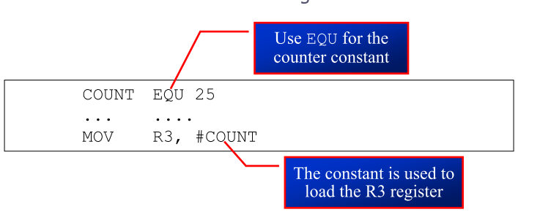
8051 DATA TYPES AND DIRECTIVES Assembler Directives (cont’)
EQU (equate) (cont’)
Assume that there is a constant used in many different places in the program, and the programmer wants to change its value throughout
By the use of EQU, one can change it once and the assembler will change all of its occurrences

Slide 5
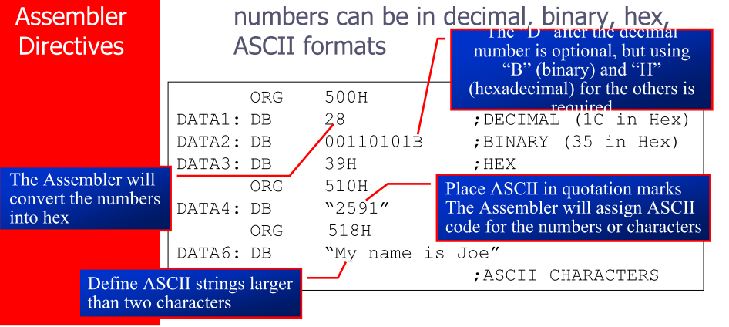

8051 DATA TYPES AND DIRECTIVES Assembler Directives
The DB directive is the most widely used data directive in the assembler
It is used to define the 8-bit data
When DB is used to define data, the numbers can be in decimal, binary, hex, ASCII formats

Slide 6
FLAG BITS AND PSW REGISTER Program Status Word
The program status word (PSW) register, also referred to as the flag register., is an 8 bit register
Only 6 bits are used
These four are CY (carry), AC (auxiliary carry), P (parity), and OV (overflow)
They are called conditional flags, meaning that they indicate some conditions that resulted after an instruction was executed
The PSW3 and PSW4 are designed as RS0 and RS1, and are used to change the bank
The two unused bits are user-definable

Slide 7
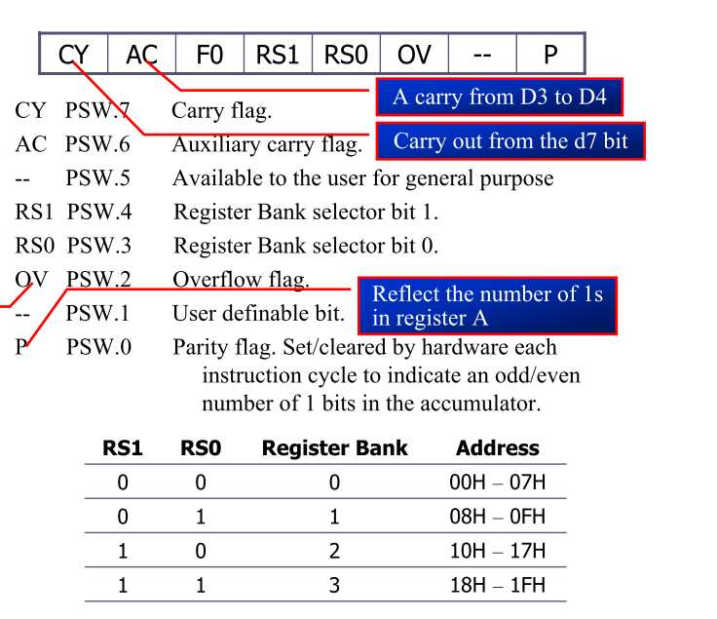
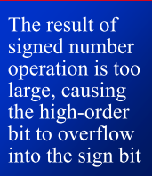
Program Status Word (cont’)

Slide 8
A register is used for many arithmetic operations and all data transfer between 8051 and external memory
B register is used along with A register for multiplication and division operations

Slide 9
ADDRESSING MODES
The CPU can access data in various ways, which are called addressing modes
Immediate
Register
Direct
Register indirect
Indexed Accessing memories

Slide 10
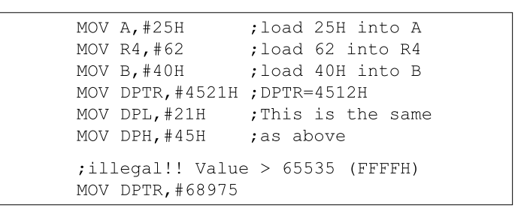
IMMEDIATE ADDRESSING MODE
The source operand is a constant
The immediate data must be preceded by the pound sign, “#”
Can load information into any registers, including 16-bit DPTR register
DPTR can also be accessed as two 8-bit registers, the high byte DPH and low byte DPL

Slide 11
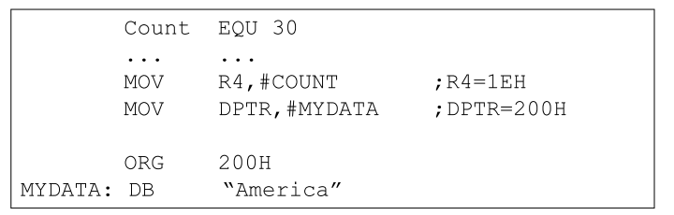

IMMEDIATE ADDRESSING MODE (cont’)
We can use EQU directive to access immediate data
We can also use immediate addressing mode to send data to 8051 ports

Slide 12
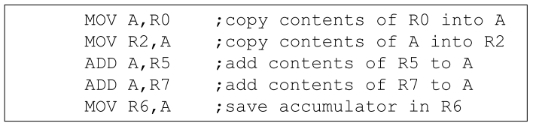
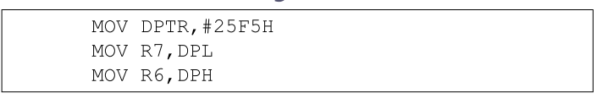
REGISTER ADDRESSING MODE
Use register to hold the data to be manipulated
The source and destination registers must match in size
MOV DPTR,A will give an errors
The movement of data between Rn registers is not allowed
MOV R4,R7 is invalid
Register moves between A and any register Rn

Slide 13

ACCESSING MEMORY Direct Addressing Mode
Direct addressing mode is most often used to access RAM locations 30 – 7FH
The entire 128 bytes of RAM can be accessed
The register bank locations are accessed by the register names
MOV A,4 ;is same as
MOV A,R4 ;which means copy R4 into A
Contrast this with immediate addressing mode
There is no “#” sign in the operand
MOV R0,40H ;save content of 40H in R0
MOV 56H,A ;save content of A in 56H
Direct addressing mode
Register addressing mode

Slide 14
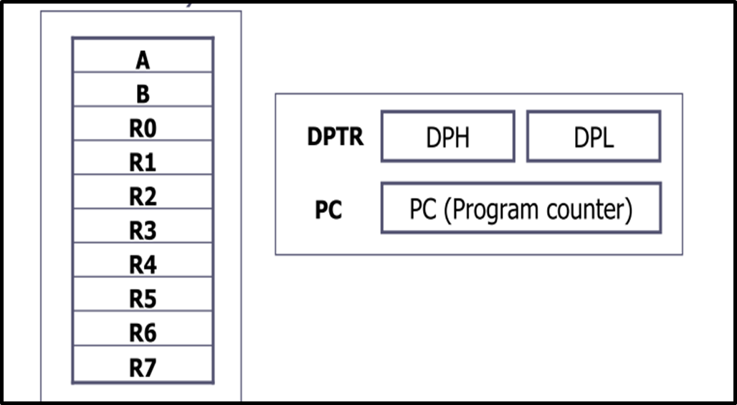

SPECIAL FUNCTION REGISTERS (SFR)

Slide 15

SFRs are programmed by instructions, they are RAM locations.
SFRs are categorized as follows:
Math registers: A and B
Status register: PSW (Program Status Word)
Program counter: PC
Pointer registers: DPTR (Data Pointer) and SP (Stack Pointer)
Input output port latches: P0, P1, P2, and P3
Peripheral data registers: TL0, TH0, TL1, TH1, and SBUF
Peripheral control registers: IP, IE, TMOD, TCON, SCON, and PCON

Slide 16
ACCESSING MEMORY
SFR Registers and Their Addresses

Slide 17
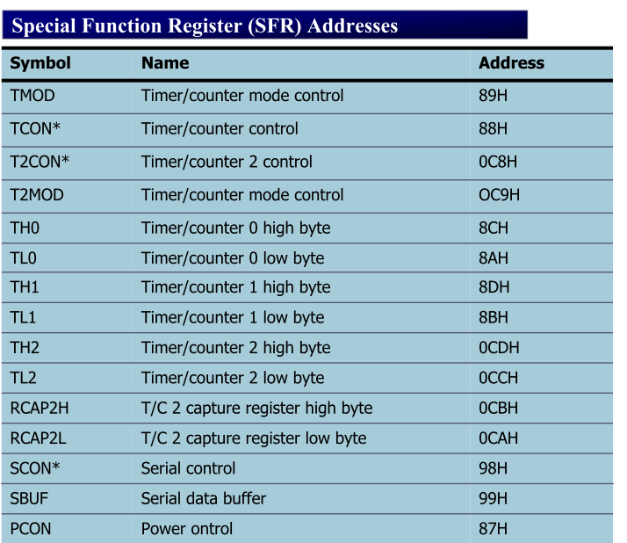
* Bit addressable
ACCESSING MEMORY
SFR Registers and Their Addresses

Slide 18
ACCESSING MEMORY SFR Registers and Their Addresses
The SFR (Special Function Register)can be accessed by their names or by their addresses
The SFR registers have addresses between 80H and FFH
Not all the address space of 80 to FF is used by SFR
The unused locations 80H to FFH are reserved and must not be used by the 8051 programmer

Slide 19
ACCESSING MEMORY SFR Registers and Their Addresses (cont’)
Write code to send 55H to ports P1 and P2, using
(a) their names (b) their addresses
Solution :
(a) MOV A,#55H ;A=55H
MOV P1,A ;P1=55H
MOV P2,A ;P2=55H
(b) From Table 5-1, P1 address=80H; P2 address=A0H
MOV A,#55H ;A=55H
MOV 80H,A ;P1=55H
MOV 0A0H,A ;P2=55H

Slide 21
ACCESSING MEMORY Stack and Direct Addressing Mode
Only direct addressing mode is allowed for pushing or popping out of the stack
PUSH A is invalid
Pushing the accumulator onto the stack must be coded as PUSH 0E0H
Show the code to push R5 and A onto the stack and then pop them back into R2 and B, where B = A and R2 = R5
Solution:
PUSH 05 ;push R5 onto stack
PUSH 0E0H ;push register A onto stack
POP 0F0H ;pop top of stack into B
;now register B = register A
POP 02 ;pop top of stack into R2
;now R2=R6

Slide 22
ACCESSING MEMORY Register Indirect Addressing Mode ( Internal Memory)
A register is used as a pointer to the data
Only register R0 and R1 are used for this purpose
R2 – R7 cannot be used to hold the address of an operand located in RAM
When R0 and R1 hold the addresses of RAM locations, they must be preceded by the “@” sign
MOV A,@R0 ;move contents of RAM whose
;address is held by R0 into A
MOV @R1,B ;move contents of B into RAM
;whose address is held by R1
The number in register Rp must be an Internal RAM address of range 00h to 7Fh.(Internal Memory)
MOV | A, @Rp | Move (indirect RAM) to A reg.
MOV | direct addr, @Rp | Move (indirect RAM) to direct addr.
MOV | @Rp, A | Move (Acc.) to indirect RAM
MOV | @Rp, #data | Move immediate data to indirect RAM
MOV | @Rp, direct addr | Move (direct addr) to indirect addr

Slide 23
ACCESSING MEMORY Register Indirect Addressing Mode
Write a program to copy the value 55H into RAM memory locations 40H to 41H using
(a) direct addressing mode, (b) register indirect addressing mode
without a loop, and (c) with a loop
(a) MOV A,#55H ;load A with value 55H
MOV 40H,A ;copy A to RAM location 40H
MOV 41H.A ;copy A to RAM location 41H
(b) MOV A,#55H ;load A with value 55H
MOV R0,#40H ;load the pointer. R0=40H
MOV @R0,A ;copy A to RAM R0 points to
INC R0 ;increment pointer. Now R0=41h
MOV @R0,A ;copy A to RAM R0 points to
(c) MOV A,#55H ;A=55H
MOV R0,#40H ;load pointer.R0=40H,
MOV R2,#02 ;load counter, R2=3
AGAIN: MOV @R0,A ;copy 55 to RAM R0 points to
INC R0 ;increment R0 pointer
DJNZ R2,AGAIN ;loop until counter = zero

Slide 24
ACCESSING MEMORY Register Indirect Addressing Mode (Internal RAM )
The advantage is that it makes accessing data dynamic rather than static as in direct addressing mode
Looping is not possible in direct addressing mode
Write a program to clear 16 RAM locations starting at RAM address 60H
Solution:
CLR A ;A=0
MOV R1,#60H ;load pointer. R1=60H
MOV R7,#16 ;load counter, R7=16
AGAIN: MOV @R1,A ;clear RAM R1 points to
INC R1 ;increment R1 pointer
DJNZ R7,AGAIN ;loop until counter=zero

Slide 25
ACCESSING MEMORY Register Indirect Addressing Mode
R0 and R1 are the only registers that can be used for pointers in register indirect addressing mode
Since R0 and R1 are 8 bits wide, their use is limited to access any information in the internal RAM
Whether accessing externally connected RAM or on-chip ROM, we need 16-bit pointer
In such case, the DPTR register is used

Slide 26
ACCESSING MEMORY Indexed Addressing Mode and MOVX
In many applications, the size of program code does not have any room to share the 64K-byte code space with data
The 8051 has another 64K bytes of memory space set aside exclusively for data storage
This data memory space is referred to as external memory and it is accessed only by the MOVX instruction
The 8051 has a total of 128K bytes of memory space
64K bytes of code and 64K bytes of data

Slide 28
ACCESSING MEMORY Register Indirect Addressing Mode (External)
In case of external indirect addressing mode, data is accessed from external memory using R0, R1 and DPTR registers.
These instructions are used to read or write data from external memory.
The following are the variations possible in this addressing mode:
MOVX A, @R0
MOVX @R1, A
MOVX A, @DPTR
MOVX @DPTR, A
NOTE:
All external moves must involve the A register.
Rp (R0 or R1) can address up to 256 locations and DPTR can address up to 64k locations. Because Rp can hold only 8-bit address and DPTR can hold 16-bit address.

Slide 29
ACCESSING MEMORY Indexed Addressing Mode MOVC
Indexed addressing mode is widely used in accessing data elements of look-up table entries located in the program ROM
In this addressing mode data is accessed from code memory using A, PC and DPTR registers.
These instructions are used to read or write data from code memory.
Whenever a lookup table (which is accessed by the program frequently) is stored in code memory then this addressing mode is used.

Slide 30
ACCESSING MEMORY Code Memory Using MOVC
The instruction used for this purpose is MOVC A , @A+DPTR
In the instruction MOVC, “C” means code
The contents of A are added to the 16-bit register DPTR to form the 16
The following are the variations possible in this addressing mode:
MOVC A, @A + PC
Ex: MOV A, #40H
MOV A, @A + DPTR /* the data present in location (DPTR) + (A) will be moved to A reg. */

Slide 31
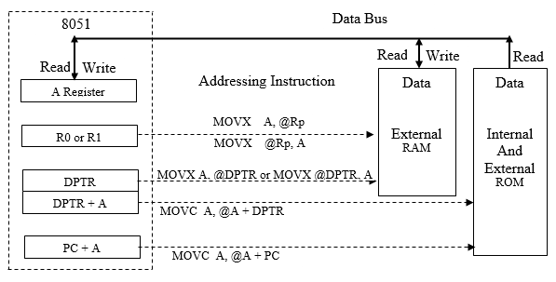
External RAM memory Addressing Using MOVX

Slide 32
External Code memory Addressing Using MOVC

Slide 33
ACCESSING MEMORY Code Memory Using MOVC
Caution:
The PC is incremented by one (to point the next instruction) before it is added to A to form the final address of the code byte.
All data is moved form the code memory to the A reg.
MOVC is used with external or internal ROM.

Slide 34
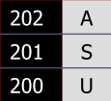
In this program, assume that the word “USA” is available in ROM locations starting at 200H. The program is burned into ROM locations starting at 0. Analyze how the program works and state where “USA” is stored after this program is run.
ORG 0000H ;burn into ROM starting at 0
MOV DPTR,#200H ;DPTR=200H look-up table addr
CLR A ;clear A(A=0)
MOVC A,@A+DPTR ;get the char from code space
MOV R0,A ;save it in R0
INC DPTR ;DPTR=201 point to next char
CLR A ;clear A(A=0)
MOVC A,@A+DPTR ;get the next char
MOV R1,A ;save it in R1
INC DPTR ;DPTR=202 point to next char
CLR A ;clear A(A=0)
MOVC A,@A+DPTR ;get the next char
MOV R2,A ;save it in R2
Here: SJMP HERE ;stay here
;Data is burned into code space starting at 200H
ORG 200H
MYDATA: DB “USA”
END ;end of program

Slide 35
BIT ADDRESSES FOR
I/O and RAM

Slide 36
ACCESSING MEMORY RAM Locations 30 – 7FH as Scratch Pad
In many applications we use RAM locations 30 – 7FH as scratch pad
We use R0 – R7 of bank 0
Leave addresses 08 – 1FH for stack usage
If we need more registers, we simply use RAM locations 30 – 7FH
Write a program to toggle P1 a total of 200 times. Use RAM location 32H to hold your counter value instead of registers R0 –R7
Solution:
MOV P1,#55H ;P1=55H
MOV 32H,#200 ;load counter value into RAM loc 32H
LOP1: CPL P1 ;toggle P1
ACALL DELAY
DJNZ 32H,LOP1 ;repeat 200 times

Slide 37
BIT ADDRESSES
Many microprocessors allow program to access registers and I/O ports in byte size only
However, in many applications we need to check a single bit
One unique and powerful feature of the 8051 is single-bit operation
It is registers, RAM, and I/O ports that need to be bit-addressable
Single-bit instructions allow the programmer to set, clear, move, and complement individual bits of a port, memory, or register
ROM, holding program code for execution, is not bit-addressable

Slide 38
BIT ADDRESSES Bit- Addressable RAM
The bit-addressable RAM location are 20H to 2FH
These 16 bytes provide 128 bits of RAM bit-addressability, since 16 × 8 = 128
0 to 127 (in decimal) or 00 to 7FH
The first byte of internal RAM location 20H has bit address 0 to 7H
The last byte of 2FH has bit address 78H to 7FH
Internal RAM locations 20-2FH are both byte-addressable and bit addressable
Bit address 00-7FH belong to RAM byte addresses 20-2FH
Bit address 80-F7H belong to SFR P0, P1, …

Slide 39
BIT ADDRESSES Bit- Addressable RAM (cont’)

Slide 40
BIT ADDRESSES Bit- Addressable RAM (cont’)
Find out to which by each of the following bits belongs. Give the address of the RAM byte in hex
(a) SETB 42H, (b) CLR 67H, (c) CLR 0FH
(d) SETB 28H, (e) CLR 12, (f) SETB 05

Slide 41
BIT ADDRESSES Bit- Addressable RAM (cont’)
To avoid confusion regarding the addresses 00 – 7FH
The 128 bytes of RAM have the byte addresses of 00 – 7FH can be accessed in byte size using various addressing modes
Direct and register-indirect
The 16 bytes of RAM locations 20 – 2FHhave bit address of 00 – 7FH
We can use only the single-bit instructions and these instructions use only direct addressing mode

Slide 42
BIT ADDRESSES Bit- Addressable RAM (cont’)
Instructions that are used for signal-bit operations are as following

Slide 43
BIT ADDRESSES I/O Port Bit Addresses (cont’)

Slide 44
BIT ADDRESSES I/O Port Bit Addresses
While all of the SFR registers are byte addressable, some of them are also bit addressable
The P0 – P3 are bit addressable
We can access either the entire 8 bits or any single bit of I/O ports P0, P1, P2, and P3 without altering the rest
When accessing a port in a single-bit manner, we use the syntax SETB X.Y
X is the port number P0, P1, P2, or P3
Y is the desired bit number from 0 to 7 for data bits D0 to D7
ex. SETB P1.5 sets bit 5 of port 1 high

Slide 45
BIT ADDRESSES I/O Port Bit Addresses (cont’)
Notice that when code such as SETB P1.0 is assembled, it become SETB 90H
The bit address for I/O ports
P0 are 80H to 87H
P1 are 90H to 97H
P2 are A0H to A7H
P3 are B0H to B7H

Slide 46
BIT ADDRESSES I/O Port Bit Addresses (cont’)

Slide 47
BIT ADDRESSES Registers Bit- Addressability
Only registers A, B, PSW, IP, IE, ACC,SCON, and TCON are bit-addressable
All I/O ports are bit-addressable
In PSW register, two bits are set aside for the selection of the register banks
Upon RESET, bank 0 is selected
We can select any other banks using thebit-addressability of the PSW

Slide 48
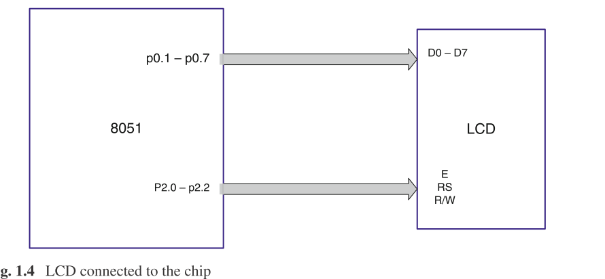

Slide 49
BIT ADDRESSES Registers Bit- Addressability (cont’)
Write a program to save the accumulator in R7 of bank 2.
CLR PSW.3
SETB PSW.4
MOV R7,A
While there are instructions such as JNC and JC to check the carry flagbit (CY), there are no such instructions for the overflow flag bit (OV).How would you write code to check OV?
JB PSW.2,TARGET ;jump if OV=1
While a program to save the status of bit P1.7 on RAM address bit 05.
MOV C,P1.7
MOV 05,C

Slide 50
BIT ADDRESSES Registers Bit- Addressability (cont’)
Write a program to see if the RAM location 37H contains an even value. If so, send it to P2. If not, make it even and then send it to P2.
MOV A,37H ;load RAM 37H into ACC
JNB ACC.0,YES ;if D0 of ACC 0? If so jump
INC A ;it’s odd, make it even
YES: MOV P2,A ;send it to P2
The status of bits P1.2 and P1.3 of I/O port P1 must be saved before
they are changed. Write a program to save the status of P1.2 in bit
location 06 and the status of P1.3 in bit location 07
CLR 06 ;clear bit addr. 06
CLR 07 ;clear bit addr. 07
JNB P1.2,OVER ;check P1.2, if 0 then jump
SETB 06 ;if P1.2=1,set bit 06 to 1
OVER: JNB P1.3,NEXT ;check P1.3, if 0 then jump
SETB 07 ;if P1.3=1,set bit 07 to 1
NEXT: ...

Slide 51
BIT ADDRESSES Using BIT directive
The BIT directive is a widely used directive to assign the bit-addressable I/O and RAM locations
Allow a program to assign the I/O or RAM bit at the beginning of the program, making it easier to modify them
A switch is connected to pin P1.7 and an LED to pin P2.0. Write a program to get the status of the switch and send it to the LED.
Solution:
LED BIT P2.0 ;assign bit
SW BIT P1.7 ;assign bit
HERE: MOV C,SW ;get the bit from the port
MOV LED,C ;send the bit to the port
SJMP HERE ;repeat forever

Slide 52
BIT ADDRESSES Using EQU
Use the EQU to assign addresses
Defined by names, like P1.7 or P2
Defined by addresses, like 97H or 0A0H
A switch is connected to pin P1.7. Write a program to check the status of the switch and make the following decision.
(a) If SW = 0, send “0” to P2
(b) If SW = 1, send “1“ to P2
SW EQU P1.7
MYDATA EQU P2
HERE: MOV C,SW
JC OVER
MOV MYDATA,#’0’
SJMP HERE
OVER: MOV MYDATA,#’1’
SJMP HERE
END

Slide 53
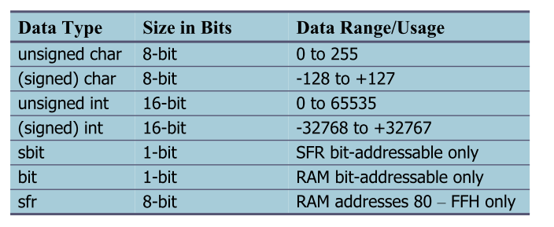
DATA TYPES Bit and sfr
The bit data type allows access to single bits of bit-addressable memory spaces 20 – 2FH
To access the byte-size SFR registers, we use the sfr data type
To access the bits in the SFR bit addressable locations, we use the sbit data type

Slide 54
sfr type
The sfr type defines a special function register (SFR). It is used as follows:
sfr name = address; Where nameis the name of the SFR.
Address is the address of the SFR.
SFRs are declared in the same fashion as other C variables. The only difference is that the type specified is sfr rather than char or int. For example:
sfr P0 = 0x80; /* Port-0, address 80h */
sfr P1 = 0x90; /* Port-1, address 90h */
sfr P2 = 0xA0; /* Port-2, address 0A0h */
P0, P1, P2, are the SFR name declarations. Any symbolic name may be used in an sfr declaration.
The address specification after the equal sign ('=') must be a numeric constant. Expressions with operators are not allowed. Classic 8051 devices support the SFR address range 0x80-0xFF.
sfr variables may not be declared inside a function. They must be declared outside of the function body.

Slide 55
DATA TYPES Single Bit (cont’)
Write an 8051 C program to toggle bit D0 of the port P1 (P1.0)
50,000 times.
Solution:
#include <reg51.h>
sbit MYBIT=P1^0;
void main(void)
{
unsigned int z;
for (z=0;z<=50000;z++)
{
MYBIT=0;
MYBIT=1;
}
}
sbit keyword allows access to the single bits of the SFR registers

Slide 56
JUMP, LOOP AND CALL INSTRUCTIONS

Slide 57
LOOP AND JUMP INSTRUCTIONS Looping
Loop action is performed by
DJNZ reg, Label
The register is decremented
If it is not zero, it jumps to the target address referred to by the label
Prior to the start of loop the register is loaded with the counter for the number of repetitions
Counter can be R0 – R7 or RAM location
;This program adds value 3 to the ACC ten times
MOV A,#0 ;A=0, clear ACC
MOV R2,#10 ;load counter R2=10
AGAIN: ADD A,#03 ;add 03 to ACC
DJNZ R2,AGAIN ;repeat until R2=0,10 times
MOV R5,A ;save A in R5

Slide 58
LOOP AND JUMP INSTRUCTIONS Nested Loop
If we want to repeat an action more times than 256, we use a loop inside a loop, which is called nested loop
We use
Write a program to (a) load the accumulator with the value 55H, and (b) complement the ACC 700 times
MOV A,#55H ;A=55H
MOV R3,#10 ;R3=10, outer loop count
NEXT: MOV R2,#70 ;R2=70, inner loop count
AGAIN: CPL A ;complement A register
DJNZ R2,AGAIN ;repeat it 70 times
DJNZ R3,NEXT multiple registers to hold the count

Slide 59
LOOP AND JUMP INSTRUCTIONS Conditional Jumps
Jump only if a certain condition is met
JZ label
MOV A,R0 ;A=R0
JZ OVER ;jump if A = 0
MOV A,R1 ;A=R1
JZ OVER ;jump if A = 0
...
OVER: ;jump if A=0
Determine if R5 contains the value 0. If so, put 55H in it.
MOV A,R5 ;copy R5 to A
JNZ NEXT ;jump if A is not zero
MOV R5,#55H
NEXT: ...

Slide 60
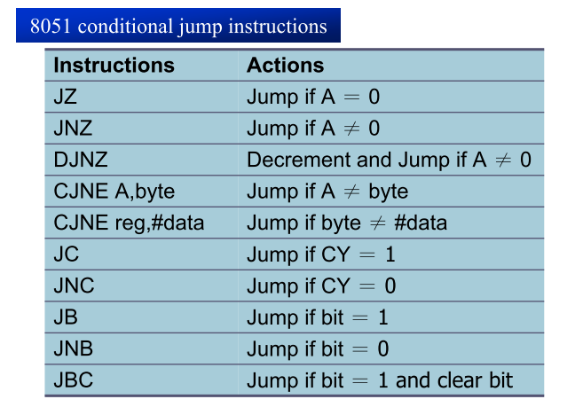
LOOP AND JUMP INSTRUCTIONS Conditional Jumps (cont’)
All conditional jumps are short jumps
The address of the target must be within
-128 to +127 bytes of the contents of PC

Slide 61
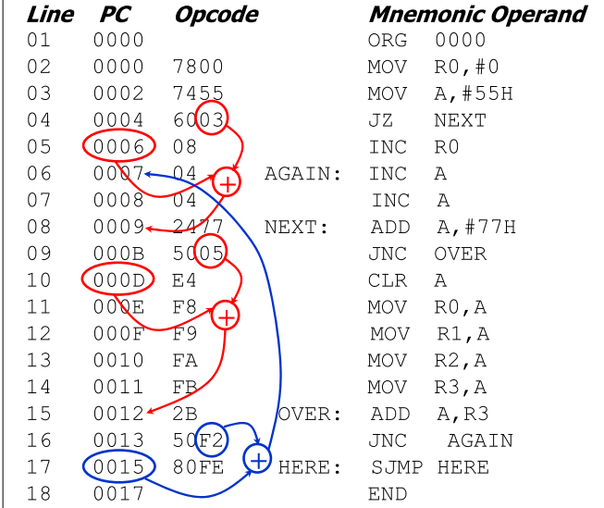
LOOP AND JUMP INSTRUCTIONS Calculating Short Jump Address To calculate the target address of a short jump ( SJMP, JNC, JZ, DJNZ, etc.
The second byte is added to the PC of the instruction immediately below the jump
If the target address is more than -128 to +127 bytes from the address below the short jump instruction
The assembler will generate an error stating the jump is out of range

Slide 62
CALL INSTRUCTIONS LCALL & ACALL
Call instruction is used to call subroutine
LCALL (long call)
3-byte instruction
First byte is the opcode
Second and third bytes are used for address of target subroutine
– Subroutine is located anywhere within 64K byte address space
ACALL (absolute call)
2-byte instruction
11 bits are used for address within 2K-byte range
The only difference between ACALL and LCALL is
The target address for LCALL can be anywhere within the 64K byte address
The target address of ACALL must be within a 2K-byte range
The use of ACALL instead of LCALL can save a number of bytes of
program ROM space

